Slide 1
Introduction to the Economics of Macro-Modelling and the System of National Accounts
Cambridge Econometrics Training Course
Hector Pollitt
September 2015

Slide 2
Overview
Introduction to macroeconomic modelling
Introduction to National Accounting
  GDP & System of National Accounts
  components of GDP
  intermediate demand and input-output relationships
  input-output modelling and multipliers
  data sources

Slide 3

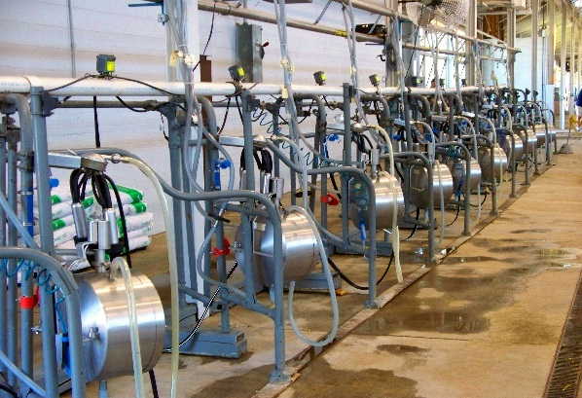

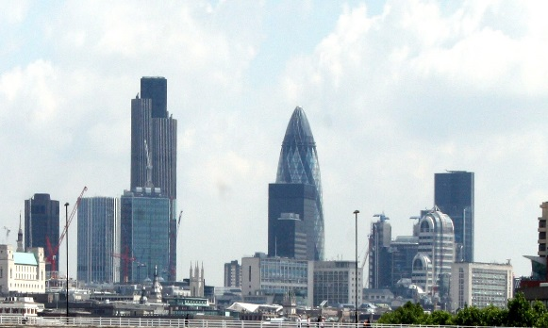

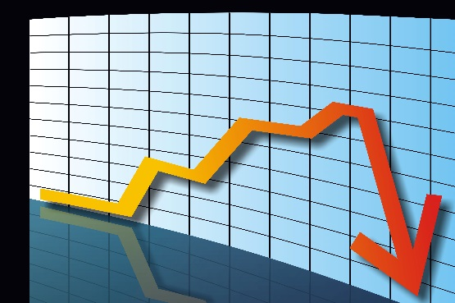
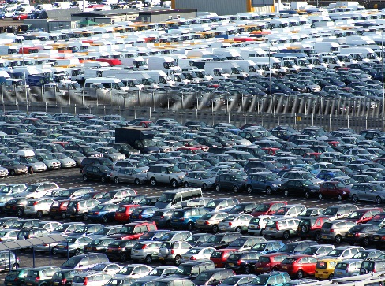
Introduction to macroeconomic modelling
Macroeconomic model: analytical tool designed to simulate interactions and dynamics of an economy

Slide 4
Economic models, macroeconomic models and macrosectoral models
Theoretical and applied models
(Partial) economic models
Pure macroeconomic models
Macrosectoral models

Slide 5
Why use macro-economic models?
  they provide a way of assessing the ‘whole economy’ impact of an event or policy change, going beyond the immediate impact which could be assessed without a macroeconomic model
  they are still the main tool for a large number of Central Banks, Finance Ministries and International organisations such as the IMF, World Bank and the OECD.
  they are useful to conduct complex analysis, with multiple inputs or outputs
  a model provides a fixed structure for analysis so that model outputs are linked in a consistent manner (most economic models are based on the system of national accounts). The use of multipliers allows indirect and induced effects to be captured.
  model development leads to an accumulation of technical expertise which impacts a model’s reputation. Repetition of application suggests that the basic methodology has been accepted and the model is a suitable tool to generate credible results by the wider community (subject to assumptions).

Slide 6
Case example
Cutting food waste by 15% means saving of €1000 per household
Impacts on household spending
Impacts on food manufacturing
Impacts on those supply to food manufacturing: agriculture sector
Costs/ investment involved with cutting food waste
GDP €?
GDP impacts = number of households x €1000
Impacts on food imports
Landfilled/ recycling sector
Jobs gain/loss
Bottom-up studies
Macroeconomic modelling

Slide 7
Case example (cont.)
How do various impacts fit together?
What do we need to know?
Answers:
structure – what are the components of GDP and supply chains: System of National Account
what drives these impacts: economic theory and estimated relationships

Slide 8



Slide 9
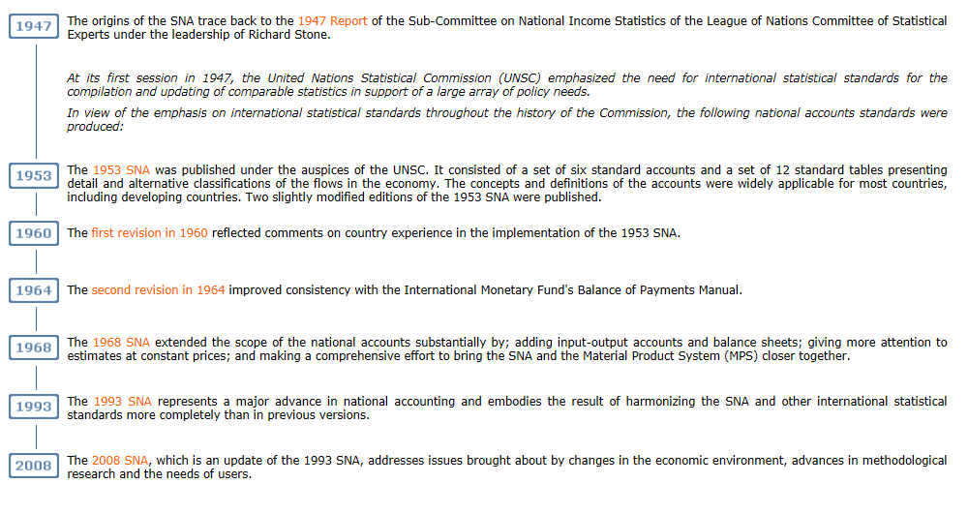
History of the National Accounts
An internationally agreed standard set of recommendations on how to compile measures of economic activity, UNSTAT, United Nations
http://unstts.un.org/unsd/ntionalaccount/sna.asp

Slide 10
System of National Accounts
Central framework for presentation and measurement of the stocks and flows in economy
Provides many key economic statistics
Simple concept of representing complex economy
  who are participants of the economy?
  what transactions do they make with one another?
Whole economy and sectors
ESA95 – European System of National and Regional Accounts

Slide 11
SNA Concepts in Macro-Modelling
GDP
Components of GDP
Intermediate demand, input-output relationships (supply chain)
Multipliers

Slide 12
Gross Domestic Product (GDP)
Main summary indicator of economic activity: growth in the economy
Three theoretical approaches to estimate GDP
  expenditure approach
  income approach
  production/output approach

Slide 13
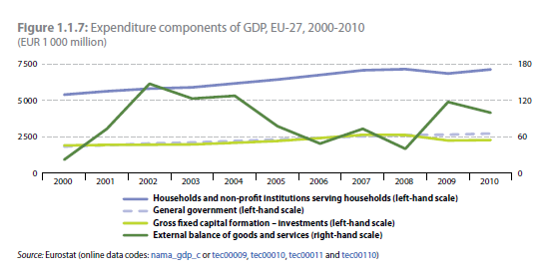
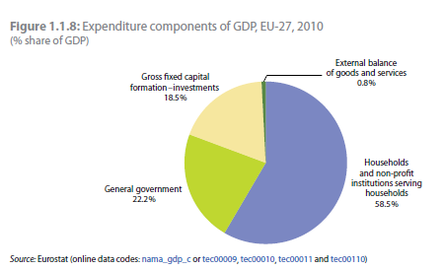
Components of GDP in Expenditure Approach
GDP = + household final consumption
+ government spending
+ investment
+ change in inventories
+ exports
– imports
GDP = total final expenditure on domestically produced goods and services

Slide 14
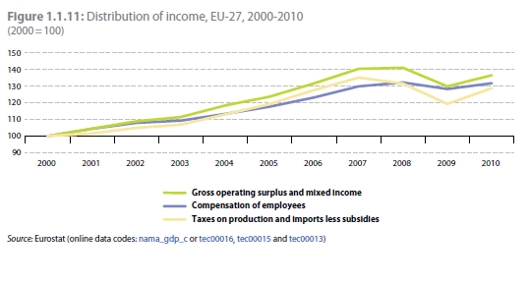
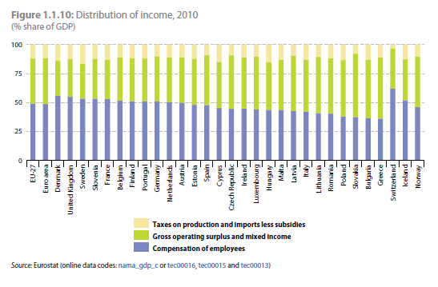
Components of GDP in Income Approach
GDP = + gross operating surplus
+ compensation of employees
+ taxes (on production)
GDP = total income

Slide 15
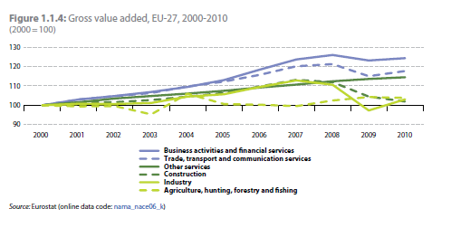
Components of GDP in Production Approach
GDP = + output
- intermediate consumption
+ taxes on products
- subsidies on products
Gross value added at basic price =
output – intermediate consumption
GDP = total value added plus taxes on production
Notes:
GDP from the output or production approach - GDP(O) measures the sum of the value added created through the production of goods and services within the economy (our production or output as an economy). This approach provides the first estimate of GDP and can be used to show how much different industries (for example, agriculture) contribute within the economy.

Slide 16
GDP Limitations
Measurement problems:
  what counts as a territory (e.g. international waters)
  what counts as output (e.g. food produced at home)
  how to value output (e.g. original artwork)
Does not represent externalities or income distribution
Measures flows but ignores production implications on stocks
  e.g. natural resources
Debate over alternative measures of well-being
Notes:
Earthquake – no negative effects on GDP but rebuilding has positive effects. Wars etc.
America’s GDP rose by $560 billion, or 3.6%, mainly because the “boundary” that defines what counts as an economic asset was moved. Makes international comparisons harder as not all countries have yet included this item.
A country’s territorial waters are within its national boundary, but foreign crews of ships working in those waters contribute to their home country’s output. Smugglers, whose activity crosses borders and is hard to track, are a real headache.
If more fruit and vegetables are grown in the garden the economy gets bigger. The logic is that home-grown produce could be sold at a market, obtain a price and be measurable. But services—cleaning a home, caring for a relative—are excluded from GDP.
The problem is that there is scant information on investment costs. Moreover, the asset—the right to the music, manuscript or TV format—is rarely sold. Rather it is used to create a future stream of products, like books and TV shows. So the BEA must estimate likely future royalty fees, and translate them into today’s money to value the investment. Since artistic assets can last a long time (“The Simpsons” has been running since 1989) that is a tough task.

Slide 17
Input-Output Tables
Analytical framework for economic relationships
  developed by Leontief for the US in 1919
  integrated to the UN’s SNA in 1968 by Richard Stone
Simple concept
raw materials
Output
Input
semi-finished goods
domestic or imports
labour

Slide 18
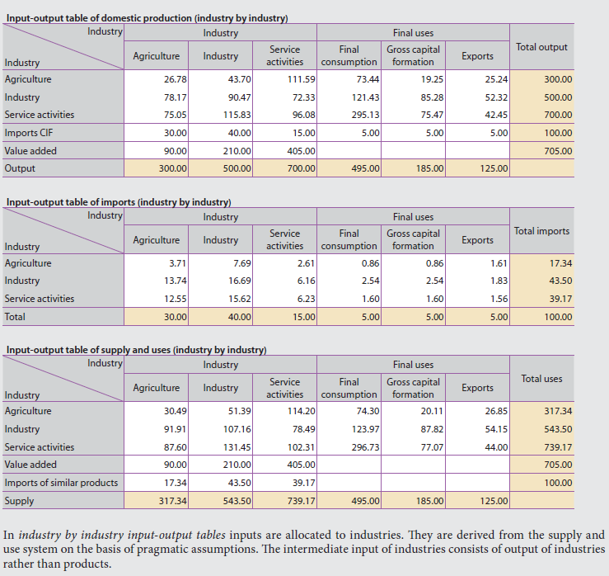

Input-Output Tables
purchase of inputs
sales of outputs

Slide 19
IO in System of National Accounts
Industries (product of)
Industries
Input-Output Table
Household Final Consumption
Government Final Consumption
Fixed Investment
Change in Inventories
Exports
Total Demand
Imports
Domestic Supply
+
+
+
+
+
=
=
+
Value Added: wages
profits deprecation
GDP expenditure approach
GDP income approach
+
Taxes and Subsides
=
GDP production approach
Gross Output

Slide 20
Input-Output Analysis
Looking at relationships between industries – supply-chain analysis
Estimate the effect of a change in final demand
  direct effects
  indirect effects
  type I multipliers
  type II multipliers

Slide 21
Multipliers
Type 1 Multipliers | Type II Multipliers
Final demand change | Final demand change
+ Direct impacts | + Direct impacts
+ Indirect impacts | + Indirect impacts
 | + Induced impacts
= Total impact | = Total impact

Slide 22
Output Multiplier Type I
$100 increase in manufacturing demand
Injection
I/O | Agr | Manf | Serv
Agr | 0.2 | 0.1 | 0.0
Manf | 0.2 | 0.3 | 0.3
Serv | 0.1 | 0.2 | 0.4
first round
$10 A
$30 M
$20 S
$2 A
$2 M
$1 S
$3 A
$9 M
$6 S
$0 A
$6 M
$8 S
second round
$0.4 A
$0.2 A
$0 A
$0.6 A
$0.9 A
$0 A
$0.6 A
$0 A
$0.4 M
$0.6 M
$0.3 M
$0.6 M
$2.7 M
$1.8 M
$1.8 M
$2.4 M
third round
$0.2 S
$0.4 S
$0.4 S
$0.3 S
$1.8 S
$2.4 S
$1.2 S
$3.2 S
Injection: M=$100
First round: A=$10, M=$30, S=$20
Second round: A=$5, M=$17, S=$15
Third round: A=$2.7, M= $10.6, S= $9.9
Agriculture: $17.7
Manufacturing: $57.6
Services: $44.9
Total: $120.2
Multiplier: $120.2/$100 = 1.202

Slide 23
Output Multiplier Type II
Agriculture: $20.2
Manufacturing: $65.9
Services: $55.2
Households: $27.4
Total: $168.7
Multiplier: $168.7/$100 = 1.687
I/O | Agr | Manf | Serv | HH
Agr | 0.2 | 0.1 | 0.0 | 0.1
Manf | 0.2 | 0.3 | 0.3 | 0.3
Serv | 0.1 | 0.2 | 0.4 | 0.4
HH | 0.3 | 0.1 | 0.2 | 0.0
$100 increase in manufacturing demand
Injection
$10 A
$30 M
$20 S
$10 H
first round
$2 A
$2 M
$1 S
$3 H
$3 A
$9 M
$6 S
$3 H
$0 A
$6 M
$8 S
$4 H
$1 A
$3 M
$4 S
$0 H
second round
$0.4 A
$0.2 A
$0.0 A
$0.3 A
$0.6 A
$0.9 A
$0.0 A
$0.3 A
$0.6 A
$0.0 A
$0.4 A
$0.2 A
$0.3 A
$0.0 A
$0.4 M
$0.6 M
$0.3 M
$0.9M
$0.6 M
$2.7 M
$1.8 M
$0.9 M
$1.8 M
$2.4 M
$1.2 M
$0.2 M
$0.9 M
$1.2 M
third round
$0.2 S
$0.4 S
$0.4 S
$1.2 S
$0.3 S
$1.8 S
$2.4 S
$1.2 S
$1.2 S
$3.2 S
$1.6 S
$0.1 S
$0.6 S
$1.6 S
$0.6 H
$0.2H
$0.2 H
$0.0 H
$0.9 H
$0.9 H
$1.2 H
$0.0H
$1.0 H
$1.0 H
$0.0 H
$0.3 H
$0.3H
$0.8H

Slide 24
Output Multiplier
Output multiplier = total impact on output /
direct impact on output
Where,
total impact on output = direct + indirect impact on output
direct impact on output = shock values
Total impact on output = (I-IO)⁻¹ *S
Where,
I = identity matrix
IO = domestic input-output table (in coefficients)
S = value of shocks

Slide 25
Value Added Multiplier
Value added multipliers are preferred over output multipliers as they eliminate double counting of expenditures
Value Added multiplier =
total (direct +indirect) value added / direct value added of initial industry

Slide 26
Value Added Multiplier Type I
$100 increase in manufacturing demand
Value Added = $100-$60 = $40
$10 A
$30 M
$20 S
= $23
$2 A
$2 M
$1 S
$3 A
$9 M
$6 S
$0 A
$6 M
$8 S
= $13.8
$0.4 A
$0.2 A
$0 A
$0.6 A
$0.9 A
$0 A
$0.6 A
$0 A
$0.4 M
$0.6 M
$0.3 M
$0.6 M
$2.7 M
$1.8 M
$1.8 M
$2.4 M
$0.2 S
$0.4 S
$0.4 S
$0.3 S
$1.8 S
$2.4 S
$1.2 S
$3.2 S
Value Added Multiplier: $($40+23+13.8)/$40= 1.92

Slide 27
Other Type of Multipliers
Multiplier | Definitions
Output | Total industry output per $1 change in final demand
Value added | Total value added per $1 change in final demand
Earning | Total household earnings per $1 change in final demand
Employment | Total number of jobs per $1 change in final demand

Slide 28
Is I-O Analysis Enough?
Yes for closed economy, static supply-chain analysis. But…
  production techniques and supply chains may change
  labour input requirements may change
  consumption patterns may change
  import propensity may change
  no supply constraints
  assume constant returns to scale
  price and quality effects are not captured
Linked to macroeconomic modelling for more complete and dynamic analysis

Slide 29
Some National Accounts Data Sources
Source | Coverage | Break down by sectors?
Eurostat | EU and candidate countries | Yes
OECD | OECD members and some non-OECD members | Yes
World Bank | Global | No aggregates only
WIOD | Major world economy | Yes
UNStat | Global | Some
GTAP | Global | Yes
National Sources | Single country | Yes and no

Slide 30
Data Classification
Variable | Classification
IO | NACE
Output/ Value Added | NACE
Household consumption | COICOP
Government spending | COFOG
Investment (made) | NACE
Import/ Export | NACE
Compensation of employees | NACE
Employment | NACE
Conversions needed for
  government
  investment
  household spending

Slide 31
Summary
System of National Accounts provides a fundamental framework for macroeconomic models
Linking SNA and IO to macroeconomic models produces a dynamic, completed, complex yet consistent tool for forecasting and scenario analysis
Macroeconomic modelling = IO + additional analysis

